Slide 1
WH – Questions using the Simple Present
Basic 03

Slide 2
First, let´s review yes/no questions

Slide 3
3-10 THE SIMPLE PRESENT: YES/NO QUESTIONS
QUESTION SHORT ANSWER
(i) Do you like ice cream?
Yes, I do.
No, I don’t.
(j) Does Max like ice cream?
Yes, he does.
No, he doesn’t.

Slide 4
3-10 THE SIMPLE PRESENT: YES/NO QUESTIONS
(h) Are you a student?
NOT possible: Do you be a student?
It´s not possible to have do as auxiliar and be
as main verb

Slide 5
In this lesson we will talk about Wh- questions using the simple present, that means getting specific information with your questions, not a Yes or No

Slide 6
3-11 THE SIMPLE PRESENT: ASKING INFORMATION
QUESTIONS WITH WHERE
QUESTION SHORT ANSWER
(a) Do they live in Ñaña?
Yes, they do.
No, they don’t.
(b) Where do they live?
They live in Cañete

Slide 7
3-11 THE SIMPLE PRESENT: ASKING INFORMATION
QUESTIONS WITH WHERE
QUESTION SHORT ANSWER
(c) Does Alexa live in Moscow?
Yes, she does.
No, she doesn’t.
(d) Where does he live?
He lives in New York.

Slide 8
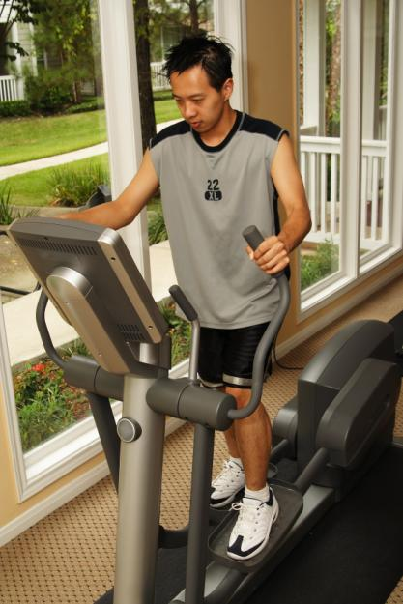
3-10 THE SIMPLE PRESENT: YES/NO QUESTIONS
Does he exercise?
Yes, he does.
Where does he exercise?
He exercises at home.

Slide 9
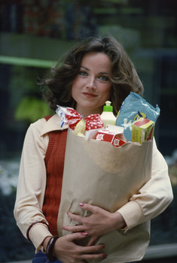
3-12 THE SIMPLE PRESENT: ASKING INFORMATION
QUESTIONS WITH WHEN AND WHAT TIME
When do you go shopping?
What time do you go shopping?

Slide 10
3-12 THE SIMPLE PRESENT: ASKING INFORMATION
QUESTIONS WITH wh-
When do you go shopping?
What does she usually buy?
Where do you go shopping?
Who does she go shopping with?

Slide 11
3-12 THE SIMPLE PRESENT: ASKING INFORMATION
QUESTIONS WITH WHEN AND WHAT TIME
Q-WORD + DO/ + SUBJECT + MAIN
DOES VERB
(a) When do you go to work?
I go to work at eight o’clock.
(b) What time do you go to work?
I go to work at eight o’clock.

Slide 12
3-12 THE SIMPLE PRESENT: ASKING INFORMATION
QUESTIONS WITH WHEN AND WHAT TIME
Q-WORD + DO/ + SUBJECT + MAIN
DOES VERB
(c) When does he exercise?
He exercises at ten o’clock.
(d) Where does he exercise?
He exercises at ten o’clock.

Slide 13
Let´s compare yes / no questions with Wh questions

Slide 14
3-11 THE SIMPLE PRESENT: ASKING INFORMATION
QUESTIONS WITH WHERE
(WHERE)
+
+
+
DO/DOES
SUBJECT
MAIN VERB
they
(a) in Surco
Do
live
?
(b) Where
do
they
live
?
(c) in Tarma
Does
Alexa
live
?
he
(d) Where
does
live
?

Slide 15
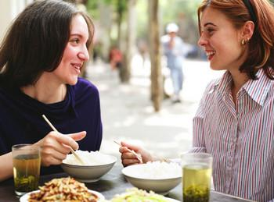
3-12 Let’s Practice
When does the restaurant close?
The restaurant closes at 9:00 P.M.

Slide 16
3-12 Let’s Practice
When do you eat lunch?
I eat lunch at 12:00.

Slide 17
3-12 Let’s Practice
I usually go to bed at 11:00.
When do you go to bed
_____________________?

Slide 18
3-13 SUMMARY: INFORMATION QUESTIONS WITH BE
AND DO
Q-WORD + DO + SUBJECT + MAIN VERB
(f) Where does she live?
She lives in Belgium.
(g) When does class start?
Class starts at 9:00 A.M.
(h) What does she play?
She plays tennis.
(i) When do you study?
I study at night.

Slide 19
Now, let´s practice

Slide 20
3-13 Let’s Practice
is are does do
do
Where ____ they buy food?

Slide 21
3-13 Let’s Practice
is are does do
does
What time _____ the train leave?

Slide 22
3-13 Let’s Practice
is are does do
is
When ____ your test?

Slide 23
3-13 Let’s Practice
is are does do
are
What ____ their names?

Slide 24
3-13 Let’s Practice
what when where who
When
______do you have dinner?
I have dinner at nice-thirty at night.

Slide 25
3-13 Let’s Practice
what when where who
Who
_____do you go shopping with?
I go shopping with my sister.

Slide 26
3-13 Let’s Practice
what when where who
What
______do you have for breakfast?
I have juice and toast.

Slide 27
3-13 Let’s Practice
what when where who
Where
______do you work?
I work at ICPNA.

Slide 28
3-13 Let’s Practice
what when where who
Who
_____do you live with?
I live with my sister.

Slide 29
3-13 Let’s Practice
what when where who
When
______do you go shopping?
I go shopping on Monday night.

Slide 30
3-13 Let’s Practice
what when where who
What
______do you buy?
I buy tomatoes, lettuce, chicken, juice, soda and onions

Slide 31
3-13 Let’s Practice
what when where who
Where
______do you buy fruits ?
I buy fruits at Wong.

Slide 32
3-13 Let’s Practice
Where do you study?
_______________?
I study at ICPNA.

Slide 33
3-13 Let’s Practice
Where does he live?
______________?
He lives in Ate.

Slide 34
3-13 Let’s Practice
When do you study?
______________?
Carla and I study at 7 a.m.

